Slide 1
Assignment 6: Radar
Part 1: Introduction to radar data
  Reno Radar
Part 2: Case study for a weather event

Slide 2
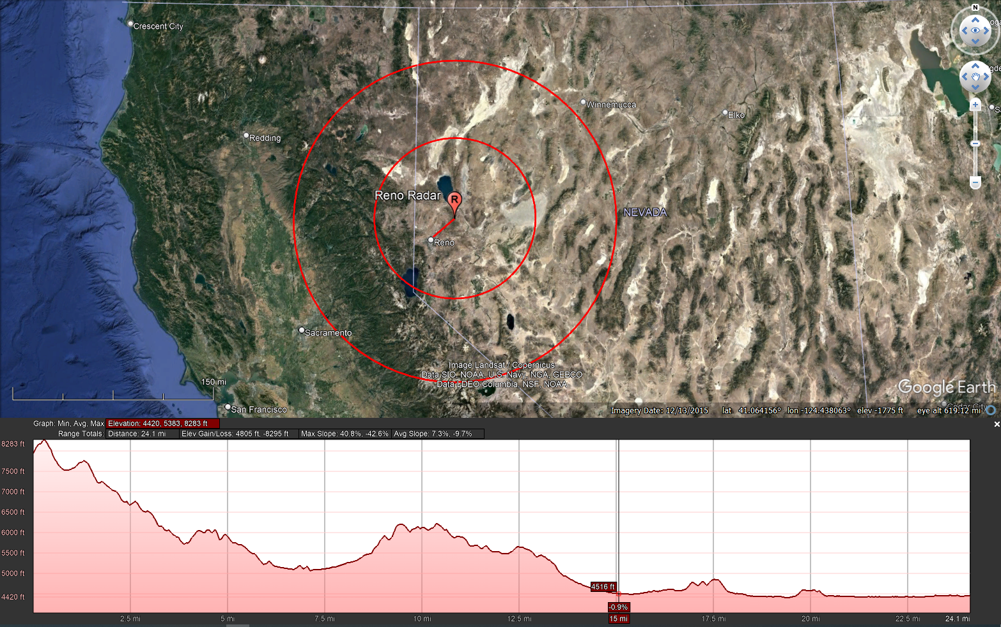
Reno Radar Broadview

Slide 3
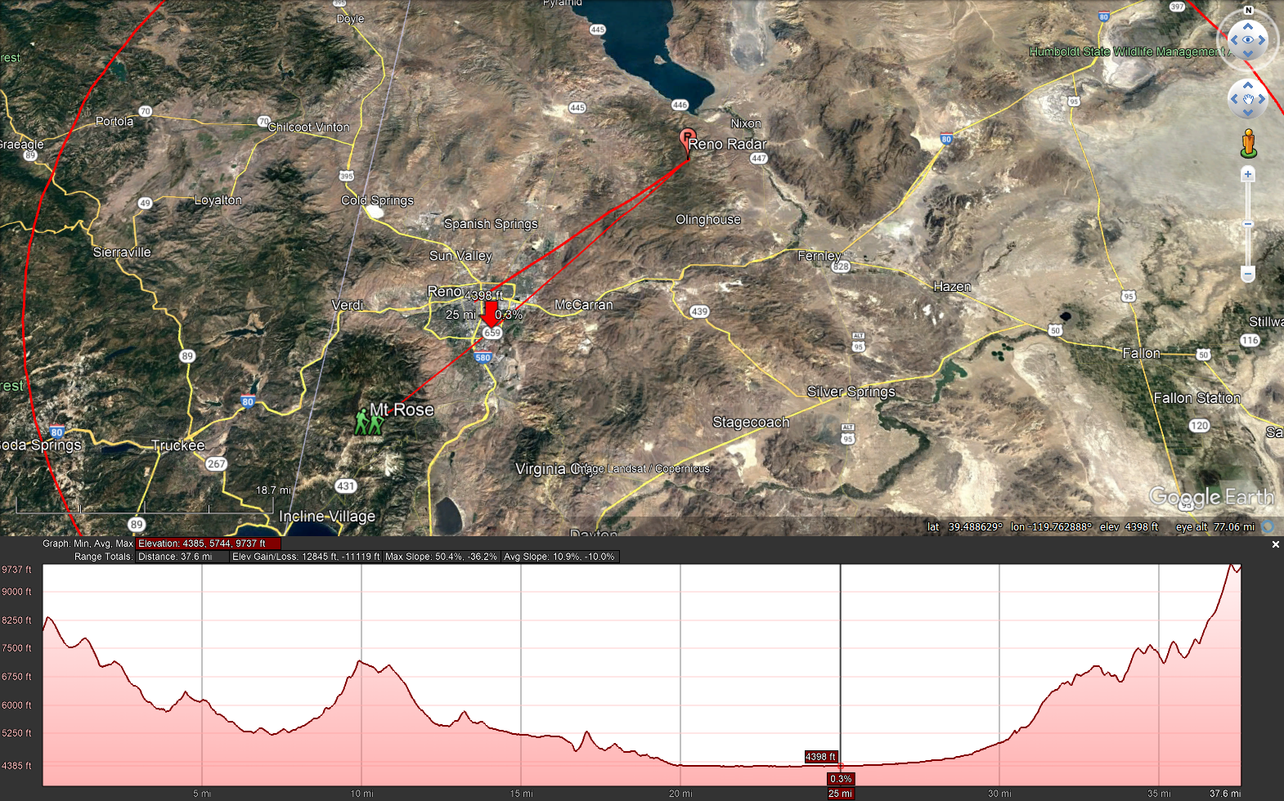
Reno Radar to Mt Rose View

Slide 4
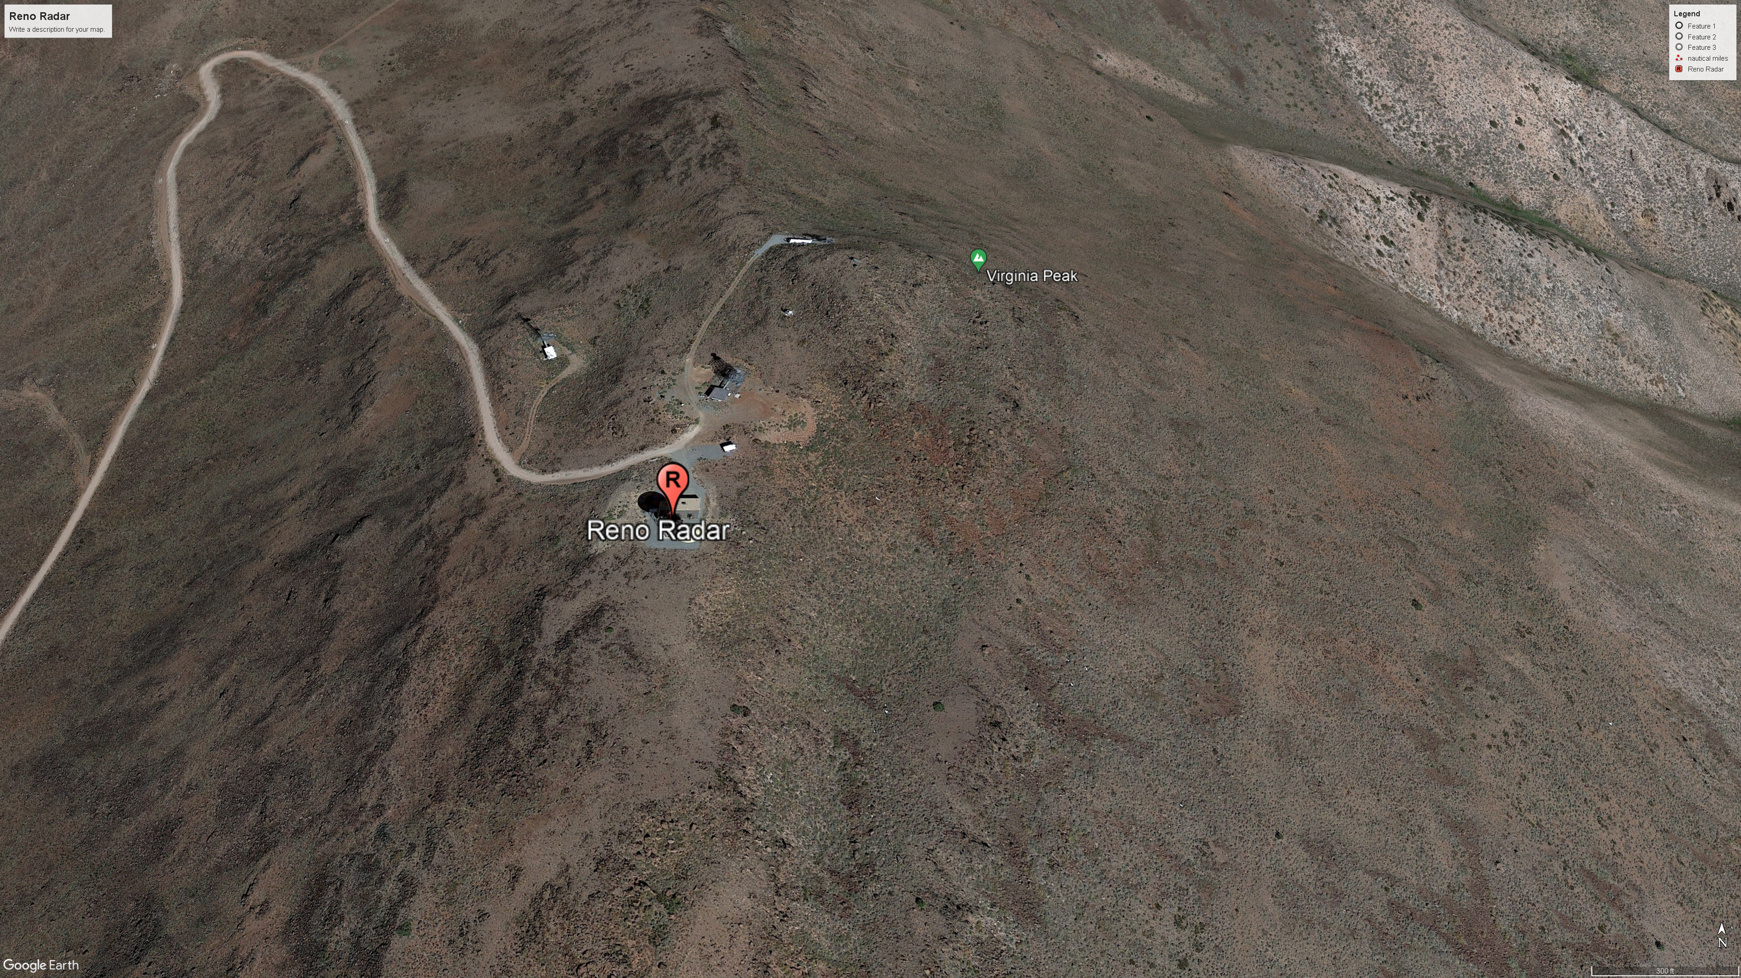
Reno Radar Details

Slide 5
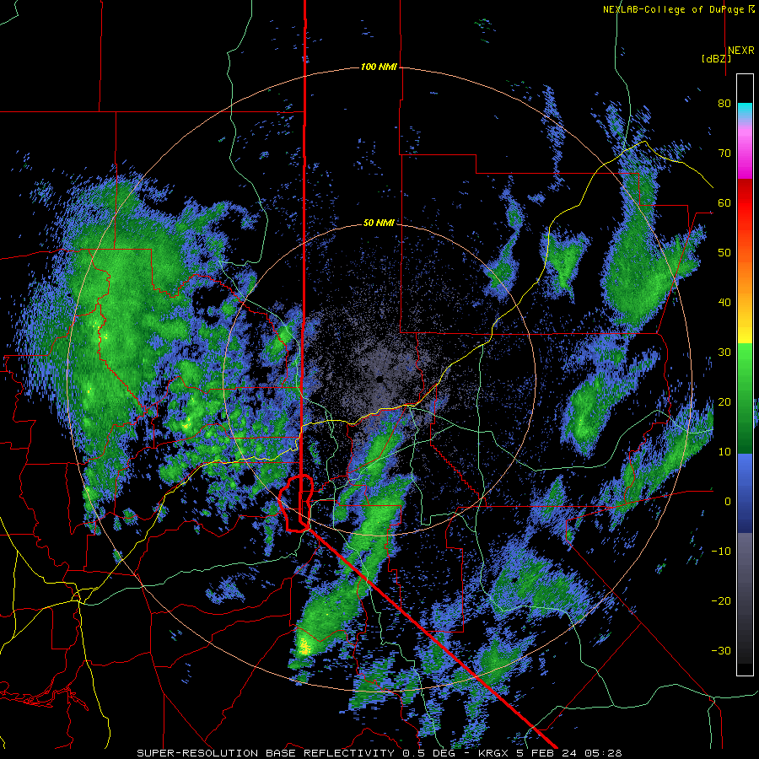
Base Reflectivity

Slide 6
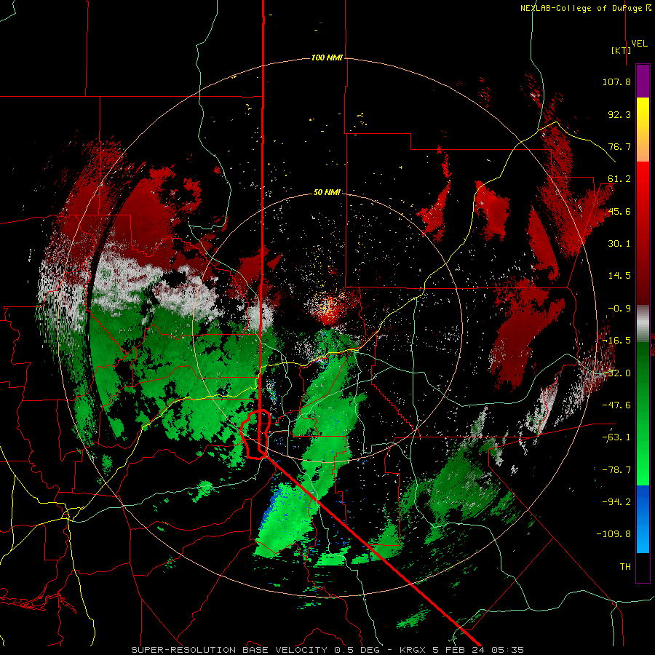
Base Velocity

Slide 7
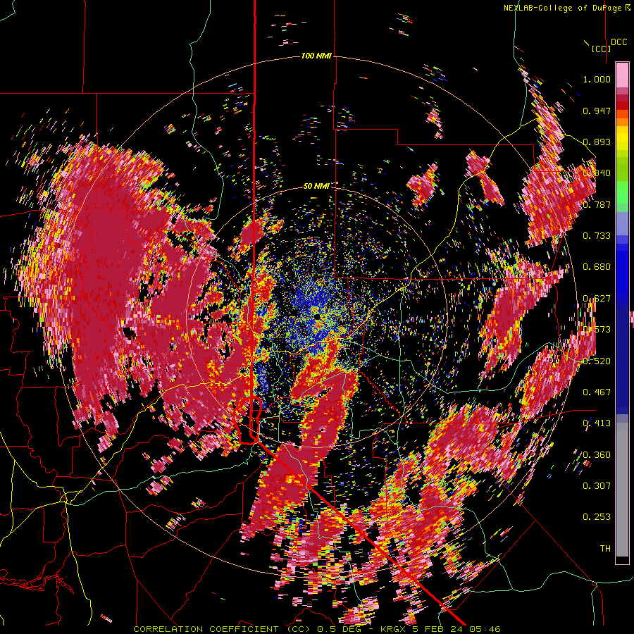
Base Correlation Coefficient

